Slide 1
Image Recognition with IBM Cloud Visual Recognition

Slide 2

Introduction to Image Recognition
Image recognition is a technology that allows computers to identify and interpret images and patterns in them. IBM cloud visual recognition is a powerful tool for implementing image recognition in your applications.

Slide 3

Image uploading
Select the image and locate the image file you want to upload on your computer.
Click image file from its location and drop it into the destination where you want to upload it..
Click the confirm button for image recognition.

Slide 4

How IBM Cloud Visual Recognition Works
IBM cloud visual recognition uses machine learning algorithms to analyse images. It can classify images into predefined categories, detect objects, and even train custom models for specific recognition tasks.

Slide 5
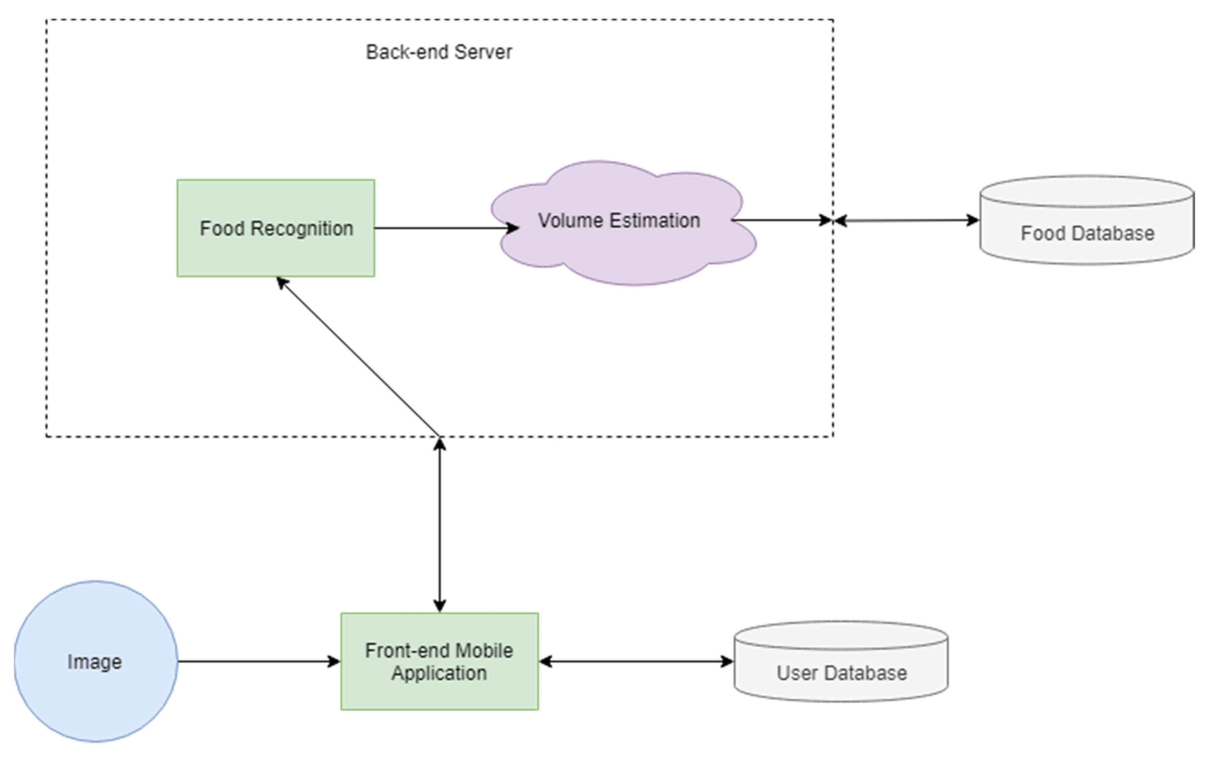
Backend and cloud connectivity

Slide 6

Applications of Image Recognition
1. Autonomous vehicles
2. Healthcare - medical image analysis
3. Retail - product recognition
4. Security - facial recognition
5. Agriculture - crop monitoring

Slide 7
Conclusion
In conclusion, IBM cloud visual recognition is a valuable tool for implementing image recognition in various domains. It offers powerful capabilities for image analysis and can be a game-changer for businesses and developers.

